Slide 1
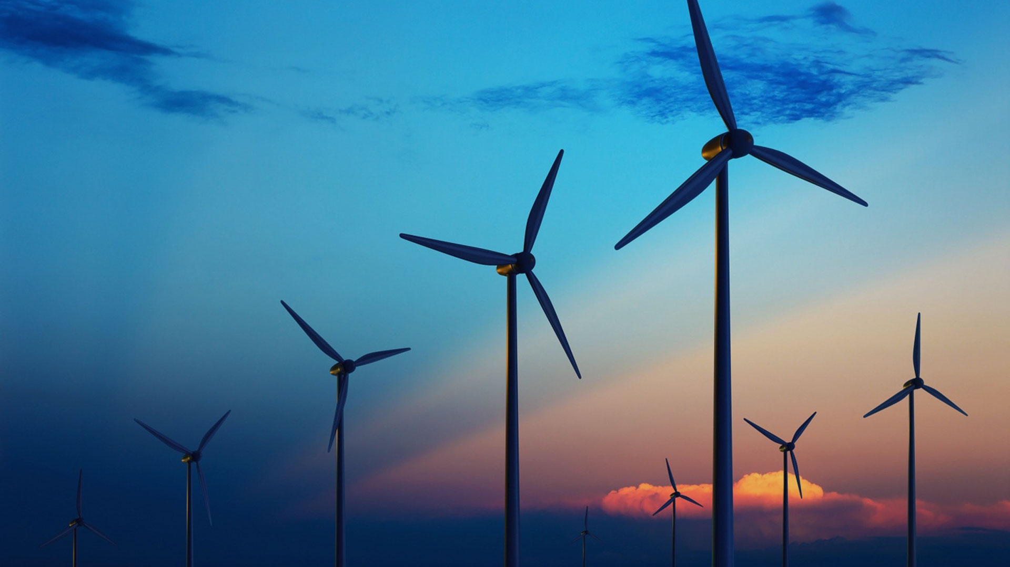



Energy consumption in Taiwan increase by 79%
Raise heavy
Environmental Impact
Importance of
Energy Efficiency
Notes:
Energy is invisible but it is important
Energy consumption over two decade in Taiwan
Supply difficulties, raise heavy environmental impacts (global warming, climate changes, etc)
Efficient energy use, is the goal to reduce the amount of energy required to provide products and services

Slide 2

Energy consumption in Taiwan increase by 79%
SMART DISPENSER
Raise heavy
Environmental Impact
Importance of
Energy Efficiency

Slide 3

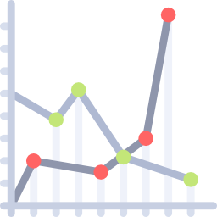


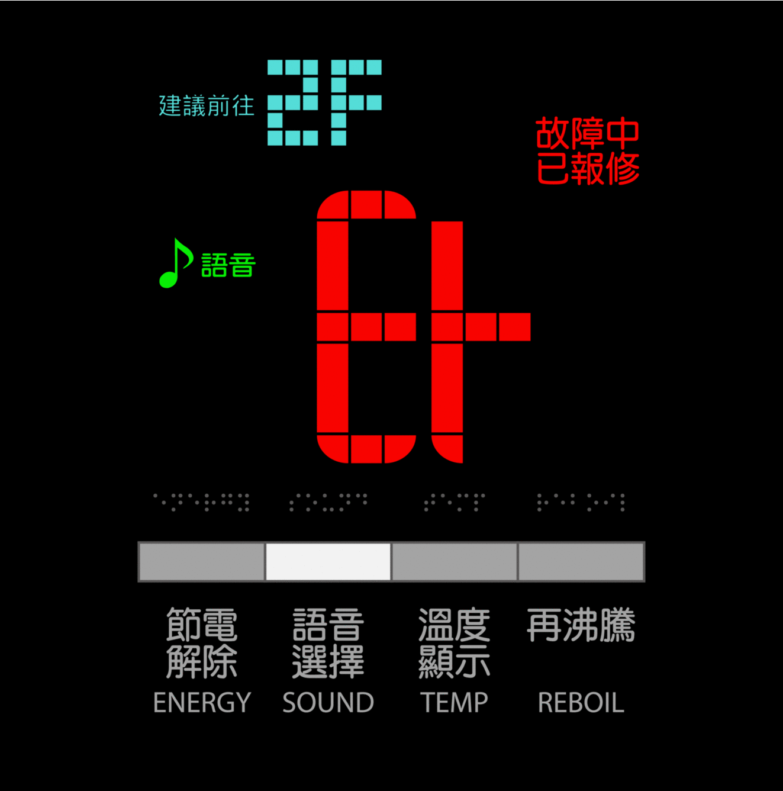








WHAT’S NEW?
User Behavior
Analytics
Predictive Analytics
Inter-Machine Communication
Predictive Maintenance
3
Monitoring &
Profiling
Analyzing
historical data
Anomaly
Detection
2
1
SMART DISPENSER

Slide 4











BUSINESS MODEL
Smart Dispenser
Data
Licensing
Percent
Incentives
Feedback
Consumer
Company
Home User
Annual
Fees
Public Building
User
Products
Services
SMART DISPENSER

Slide 5
Member
組員 | 學號 | 工作內容
邱冠期 | M10502216 | 研發
劉奕其 | M10502282 | 研發
SMART DISPENSER

Slide 6
SMART DISPENSER

